Slide 1
UI Design and Development
+Roman Nurik +Nick Butcher

Slide 2
Agenda
Designing for Android
Layouts and resources
Tablet considerations
System UI integration
UI prototyping

Slide 3
Designing for Android

Slide 4
Design for…
Touch
Interact primarily with your fingers
Expect direct manipulation
Mobile
Often on the go
Often without network connectivity
Heterogeneity
Different screen sizes and densities
Different hardware features
Different OS versions

Slide 5
Key principles
“Pictures are faster than words.”
“Only show what I need when I need it.”
“Make the important things fast.”
“Do the heavy lifting for me.”

Slide 6
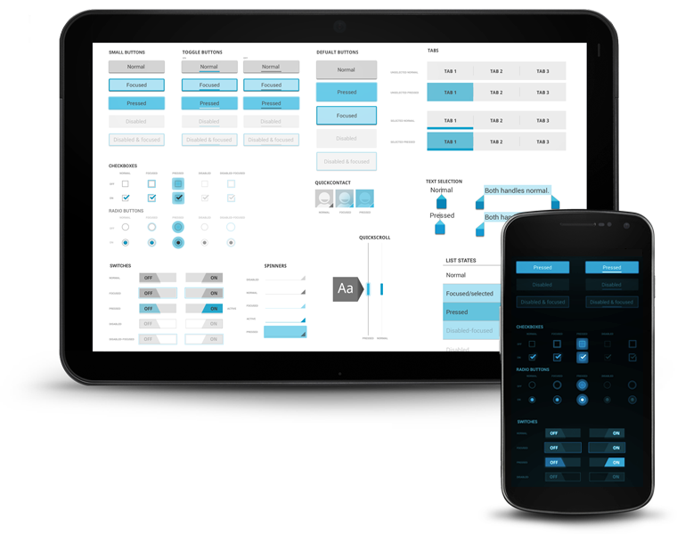
“Holo” visual language

Slide 7
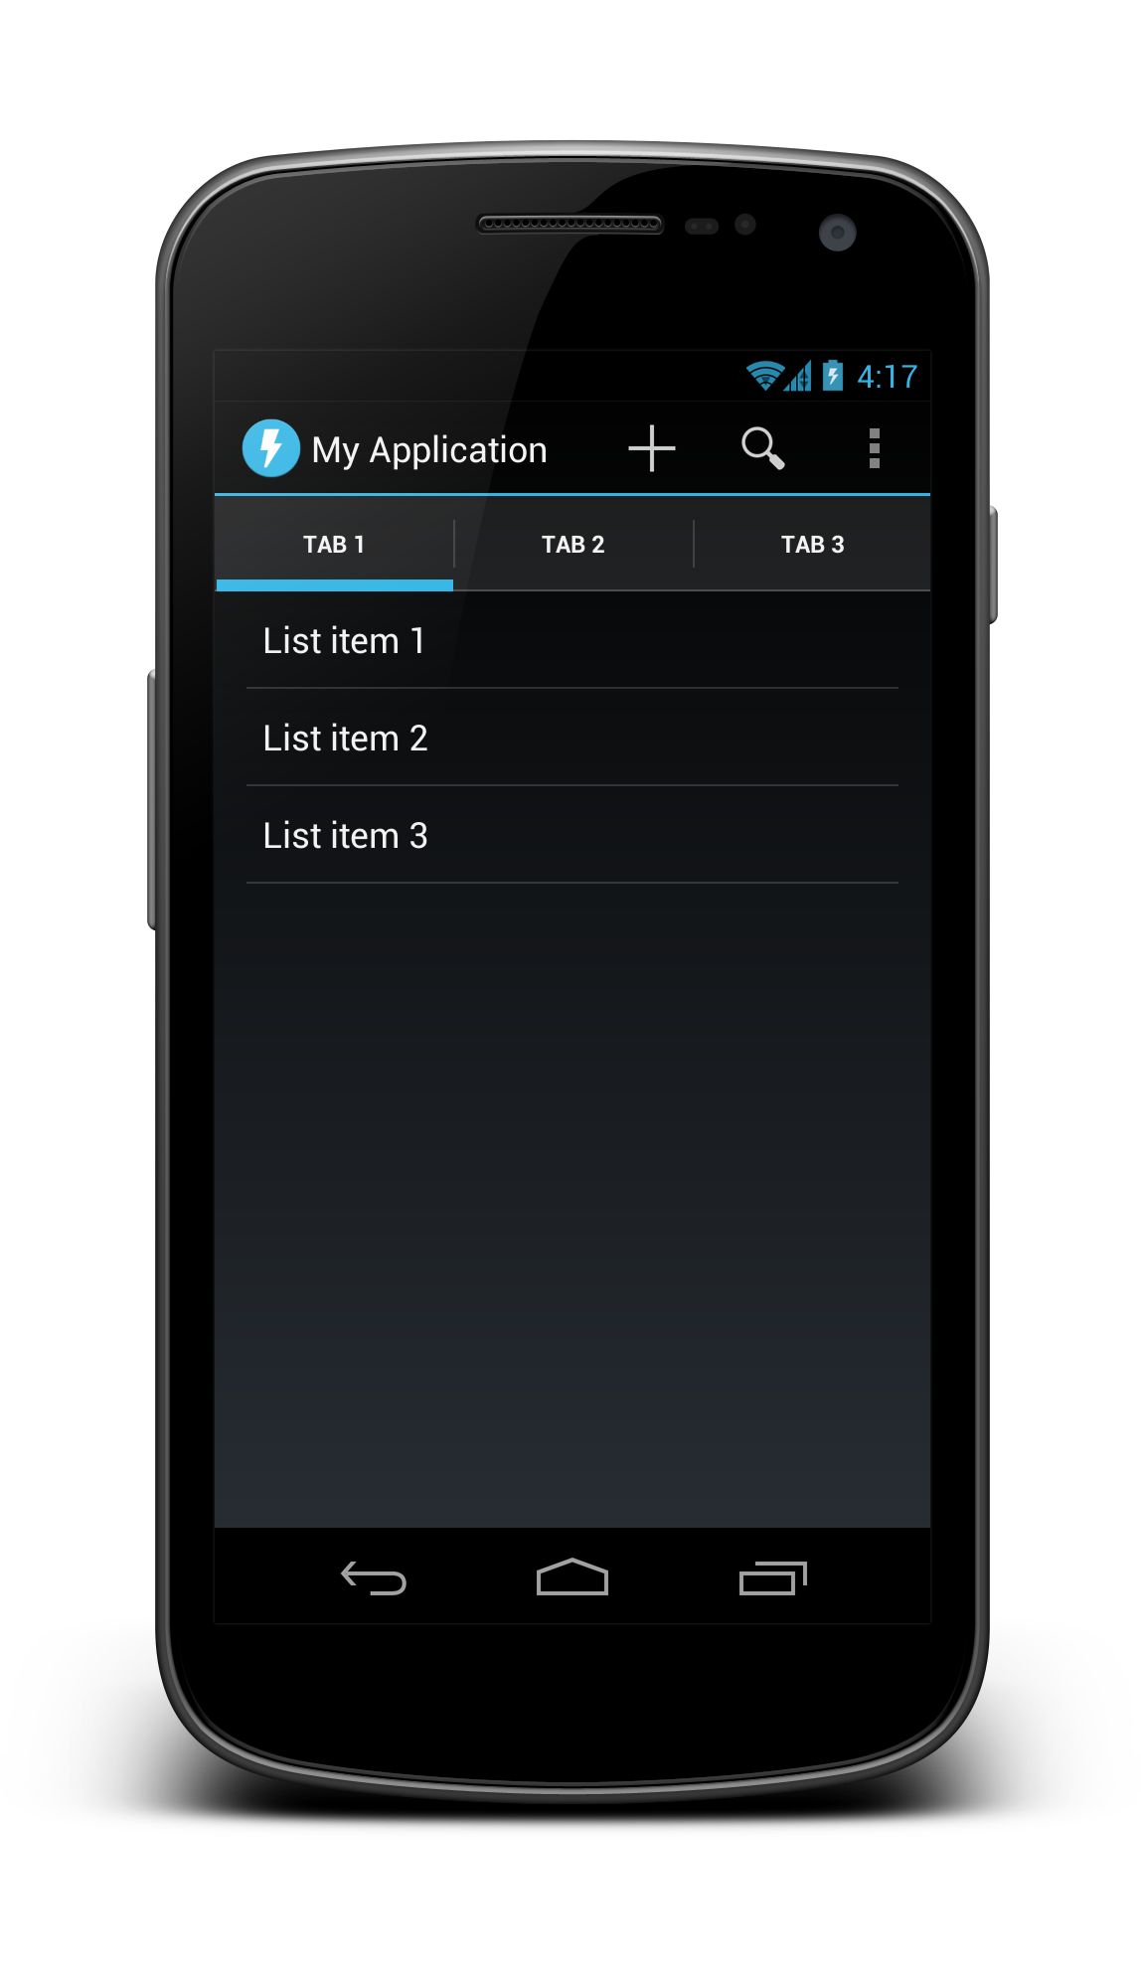
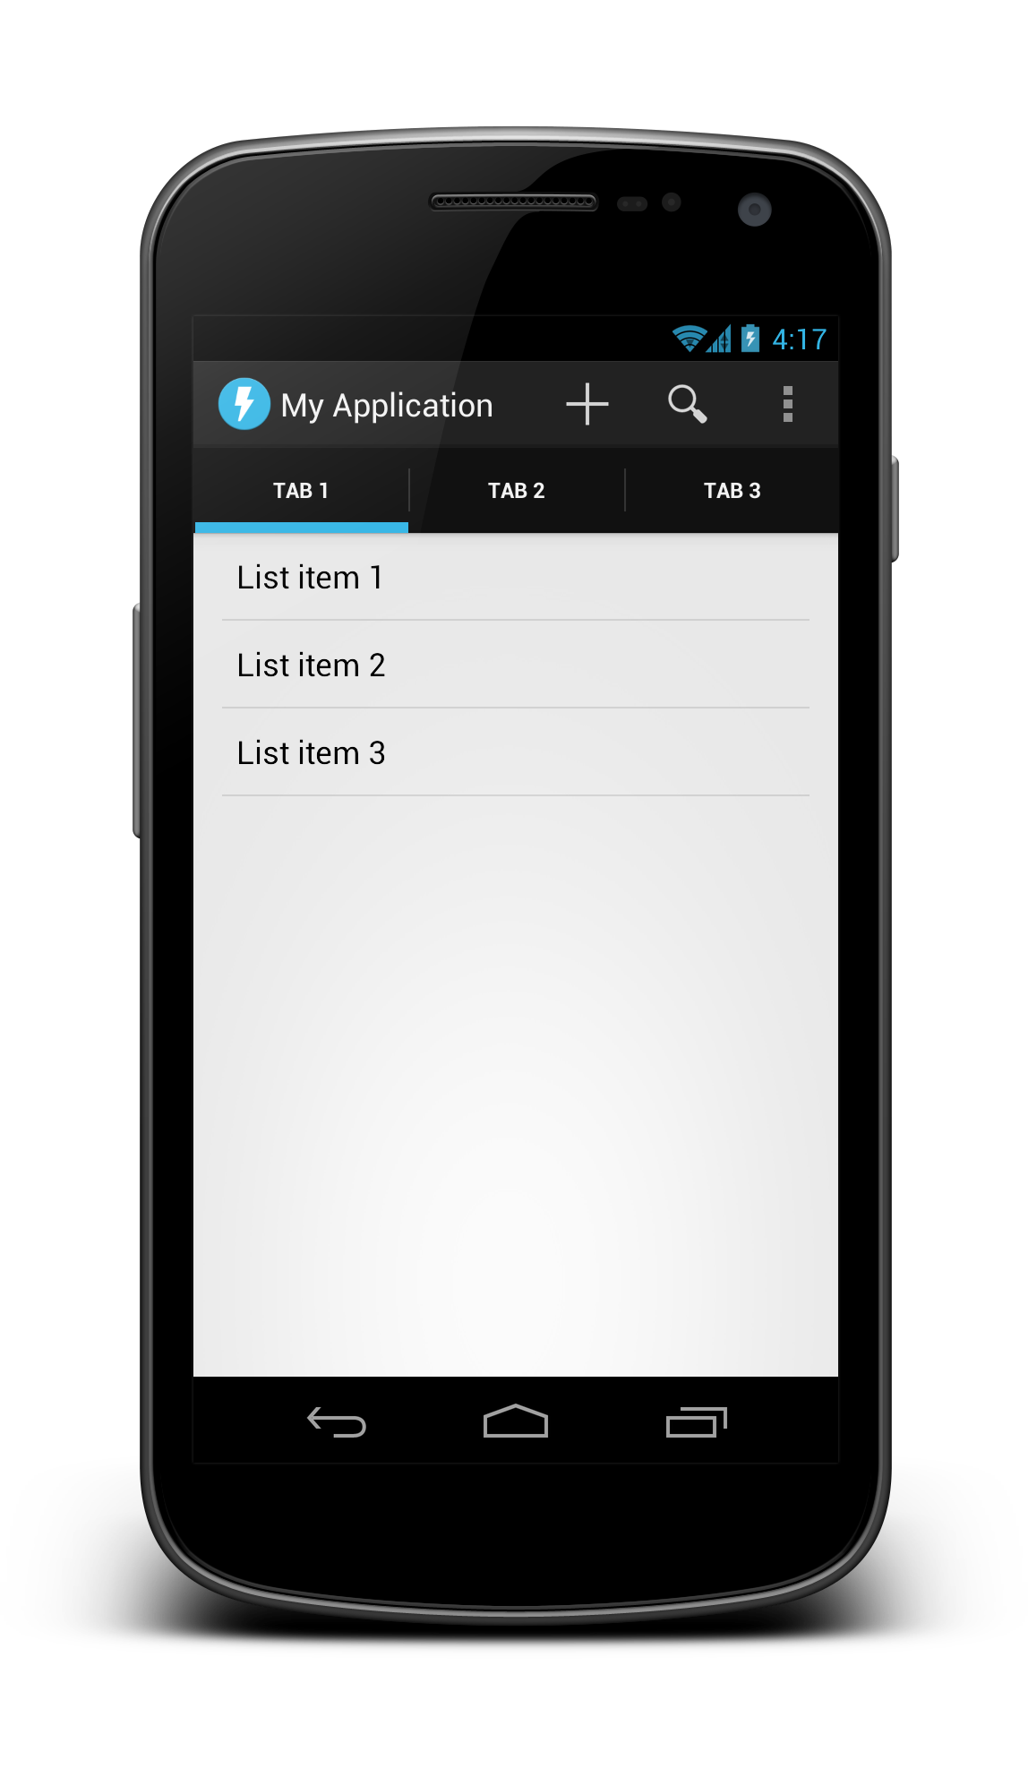
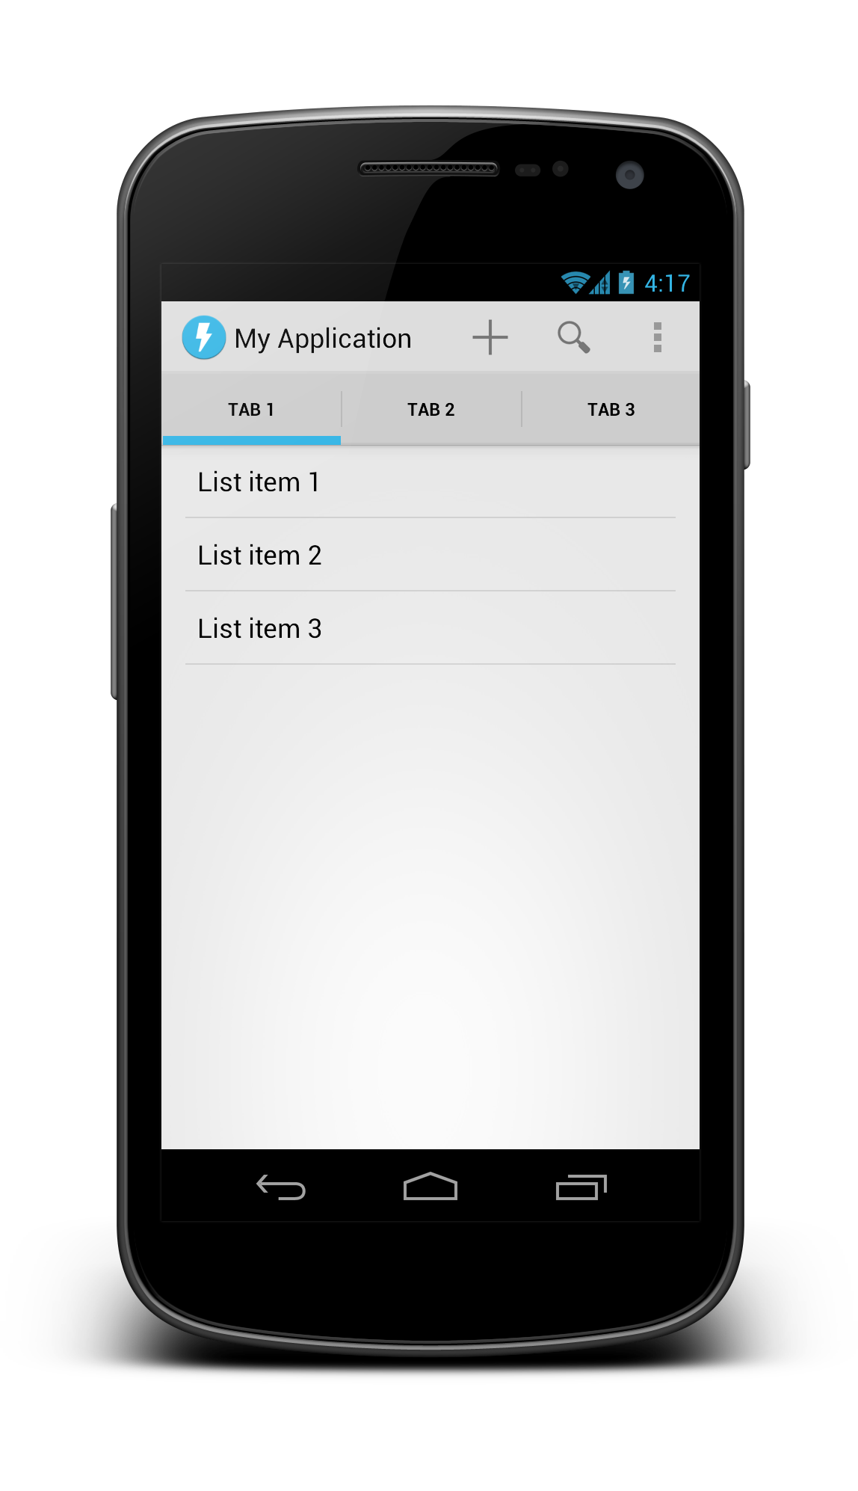
Holo variations
Dark
Dark Action Bar
Light

Slide 8
Activity UI structure
Action bar
Tabs
Content (activity layout)

Slide 9
Activity UI structure
Action bar

Slide 10
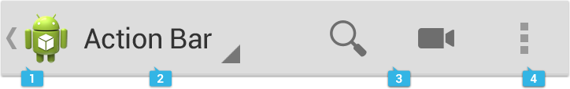
Action bar
App icon and optional Up caret
View control (Title/tabs/dropdown)
Action buttons
Action overflow

Slide 11
Action bar
Android 3.0 and above
Automatically part of Holo themes
Customize:
getActionBar().setDisplayOptions()
getActionBar().setNavigationMode()

Slide 12
Activity UI structure
Tabs

Slide 13

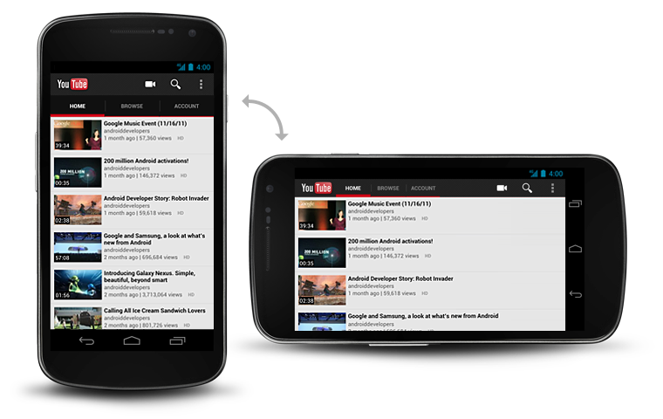
Tabs

Slide 14
Tabs
Part of the ActionBar APIs
Usually gesture-enabled using ViewPager
getActionBar().setNavigationMode(NAVIGATION_MODE_TABS);
ActionBar.Tab tab = actionBar.newTab();
tab.setText(“Tab 1”);
tab.setTabListener(this);
getActionBar().addTab(tab);

Slide 15
Activity UI structure
Content (activity layout)

Slide 16
Layouts and resources

Slide 17
Layout system
The UI for an activity is a tree consisting of view groups and views (leaf nodes).
Most commonly defined in XML under res/layout/.
<view group>
<view group>
<view>
<view group>
<view>
<view>

Slide 18
Views and View Groups
Views
View Groups
Reusable individual UI components
Optionally interactive (clickable/focusable/etc.)
Bare minimum functionality is to draw themselves
Ordered list of Views and View Groups
In charge of positioning and sizing their child views and layouts
Simple layouts and more complex groups (e.g. ListView)

Slide 19
Views and View Groups
Views
Layouts (simple View Groups)
TextView
EditText
Spinner
ImageView
Button
WebView
SurfaceView
Your own custom views
FrameLayout
LinearLayout
RelativeLayout
GridLayout
Your own custom layouts
Complex View Groups
ScrollView
ListView

Slide 20
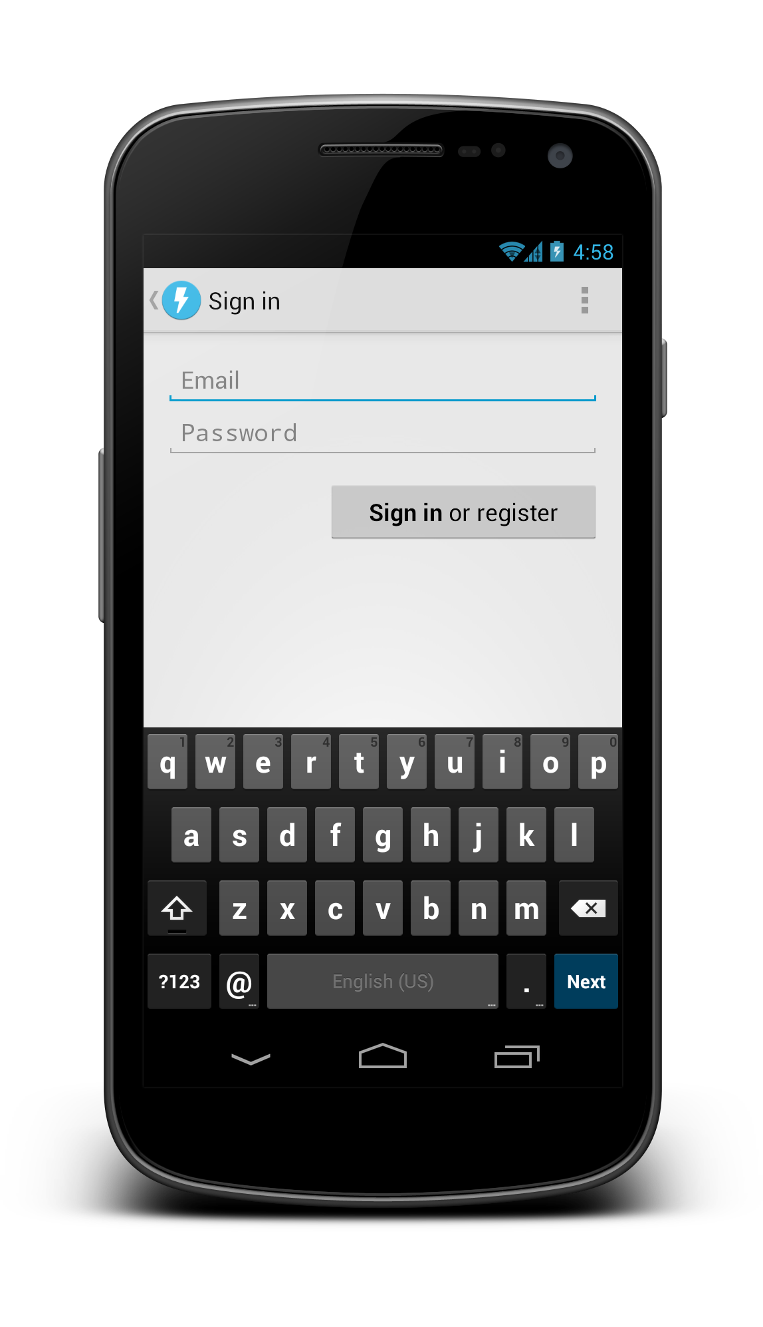
Anatomy of a simple layout

Slide 21
<FrameLayout>
<LinearLayout orientation=“vertical”>

Slide 22
<LinearLayout orientation=“vertical”>
<EditText>
<Button>
<ScrollView>

Slide 23
<ScrollView
android:layout_width="match_parent"
android:layout_height="match_parent">
<LinearLayout
android:layout_width="match_parent"
android:layout_height="wrap_content"
android:orientation="vertical"
android:padding="16dp">
<EditText
android:id="@+id/email"
android:layout_width="match_parent"
android:layout_height="wrap_content"
android:hint="@string/prompt_email"
android:inputType="textEmailAddress"
android:singleLine="true" />
<EditText
android:id="@+id/password"
android:layout_width="match_parent"
android:layout_height="wrap_content"
android:hint="@string/prompt_password"
android:inputType="textPassword"
android:maxLines="2"
android:singleLine="true" />
<Button
android:id="@+id/sign_in_button"
android:layout_width="wrap_content"
android:layout_height="wrap_content"
android:layout_gravity="right"
android:layout_marginTop="16dp"
android:paddingLeft="32dp"
android:paddingRight="32dp"
android:text="@string/action_sign_in_register" />
</LinearLayout>
</ScrollView>

Slide 24
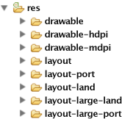
App resources
One universal app binary contains all resources
System chooses at runtime which resources to use

Slide 25
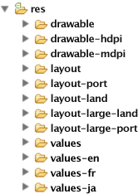

Drawable XML
PNGs, 9-patch PNGs, optimized for multi. densities
Layout XML optimized for physical size and orientation
Strings, styles, themes, etc.
Strings XML localized for your target regions

Slide 26
Screen density and DIP units
DIP units keep things the same physical size across any screen.
1 dip = 1 pixel @ MDPI (160 dpi)
1 dip = 2 pixels @ XHDPI (320 dpi)

Slide 27
Q: What is the Nexus 7’s screen resolution in DIPs if it’s 1280x800 px and 213dpi?
A: ~960x600 dip

Slide 28
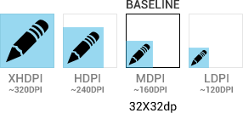
Screen density and DIP units
Icons and other PNG files should generally be provided for multiple densities

Slide 29
Drawables
Bitmaps (.png)
9-patches (.9.png)
State Lists (.xml)
Basic Vector Shapes (.xml)
Color Drawables (.xml)

Slide 30
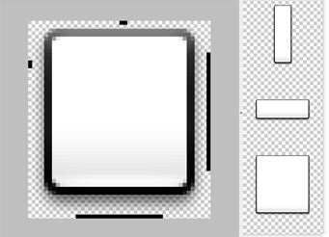
9-patches – foo.9.png
Border pixels indicate stretchable regions
Make density-specific versions (-xhdpi)

Slide 31
State Lists (selector)
foo.xml:
<selector>
<item android:drawable="@drawable/foo_disabled"
android:state_enabled="false" ... />
<item android:drawable="@drawable/foo_pressed"
android:state_pressed="true" ... />
<item android:drawable="@drawable/foo_focused"
android:state_focused="true" ... />
<item android:drawable="@drawable/foo_default" />
</selector>

Slide 32








State Lists (selector)
foo_default.png foo_disabled.png foo_focused.png foo_pressed.png
foo_default.png foo_disabled.png foo_focused.png foo_pressed.png

Slide 33
Tablet considerations

Slide 34
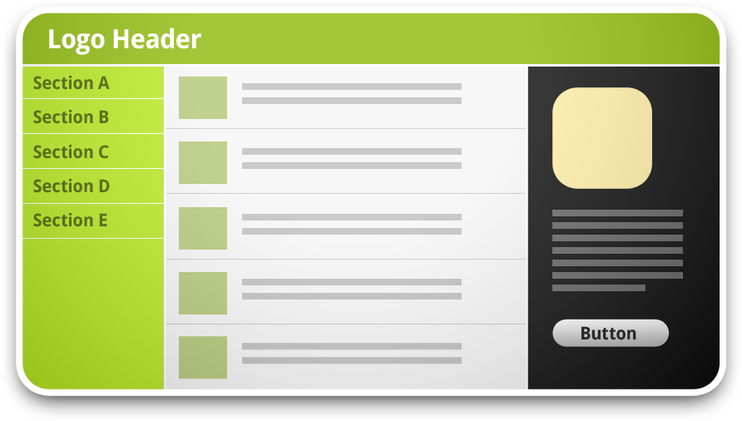
Information hierarchy and flow
Traditional desktop app or website

Slide 35
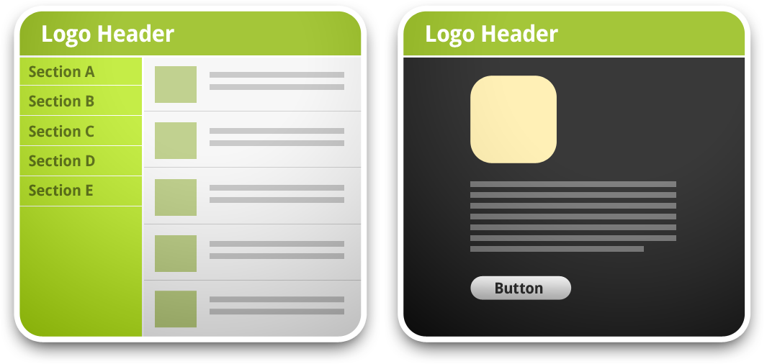
Information hierarchy and flow
Tablet or mini desktop app

Slide 36
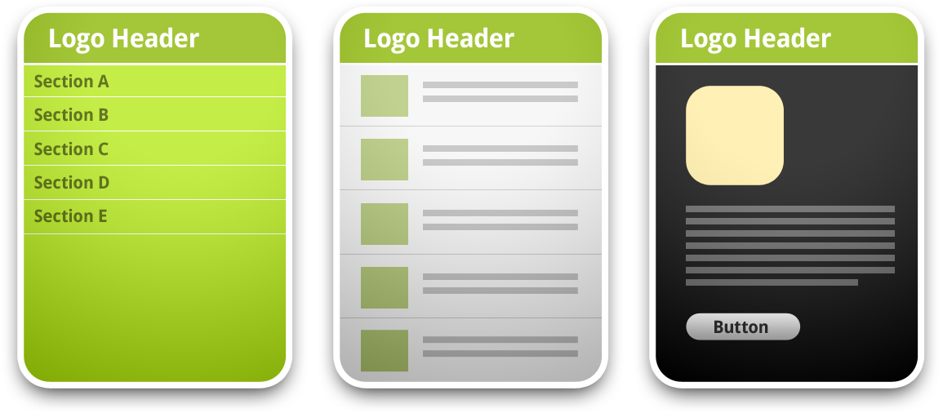
Information hierarchy and flow
Mobile phone

Slide 37
Fragments
A single piece of UI and/or implementation of an Activity, defined in its own class
Help with supporting phones + tablets
<fragment> in layout XML
Automatically instantiates the given fragment
Acts as a placeholder for the fragment’s view to be inserted in that part of the layout tree

Slide 38
System UI integration

Slide 39
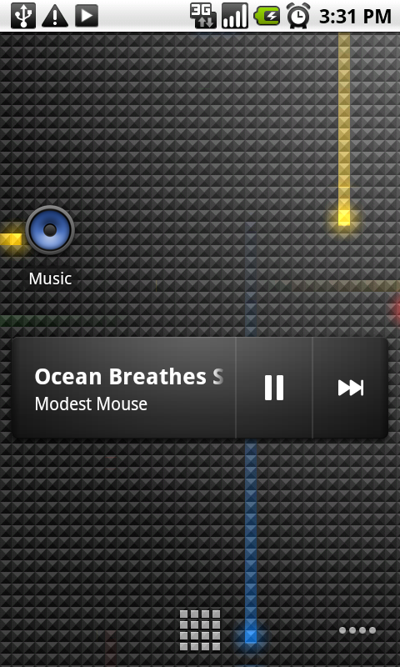
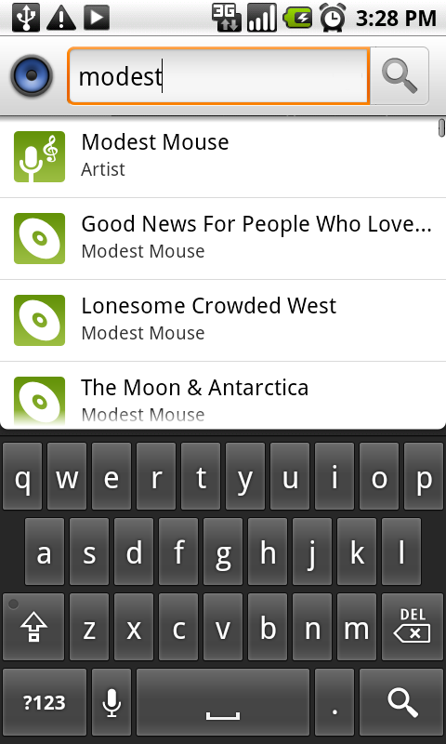
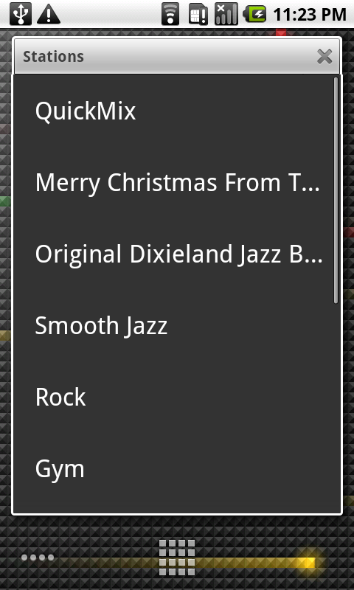
System UI integration

Slide 40
UI prototyping

Slide 41
Why prototype?
Record your ideas and asses their real-world feasability
Test your your ideas and rapidly iterate
See which work and which don’t, evolve them
Map out user flow and activity diagrams
Re-arrange/add/remove interactions quickly
Scope UI complexity
Plan out intra-app “Intent-based API”

Slide 42
Without prototyping, you’ll find yourself doing a lot of UI refactoring. ☹

Slide 43
Lots of wireframing tools
Time/Effort
Photoshop
Fireworks
OmniGraffle (Mac)
Keynote/Powerpoint
Eclipse Layout Editor
Balsamiq
Pencil (Firefox addon)
Sketches
Fidelity

Slide 44
Interactive (clickable) wireframes
Time/Effort
Photoshop
Fireworks
OmniGraffle (Mac)
Keynote/Powerpoint
Eclipse Layout Editor
Balsamiq
Pencil (Firefox addon)
Sketches
Fidelity

Slide 45
Always start with pencil and paper. (or a whiteboard)

Slide 46
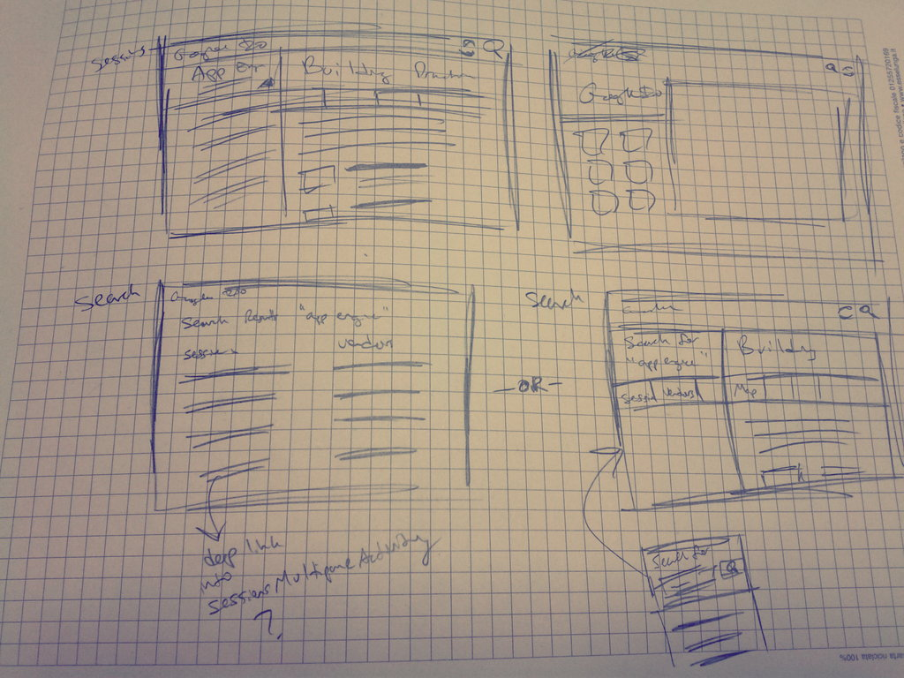
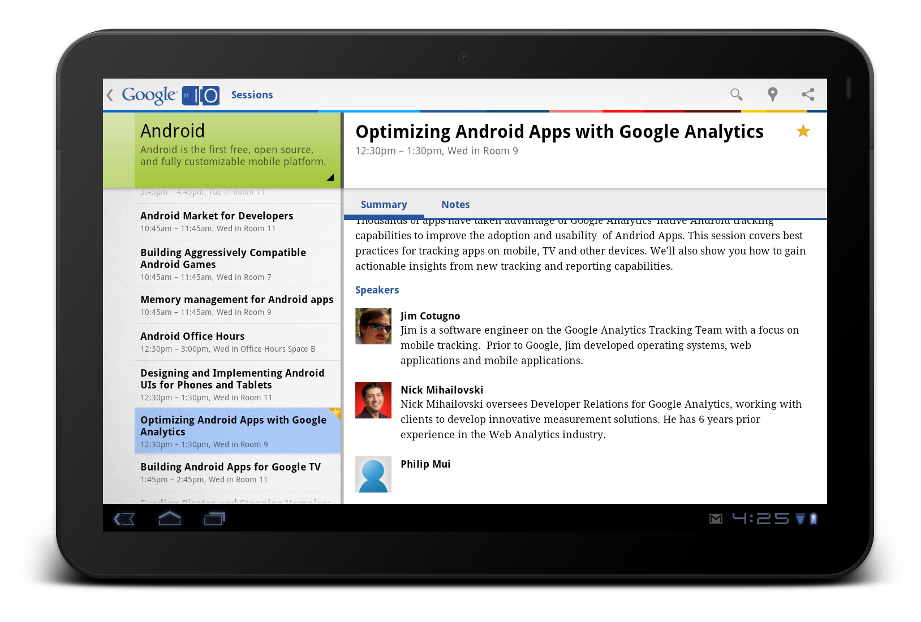
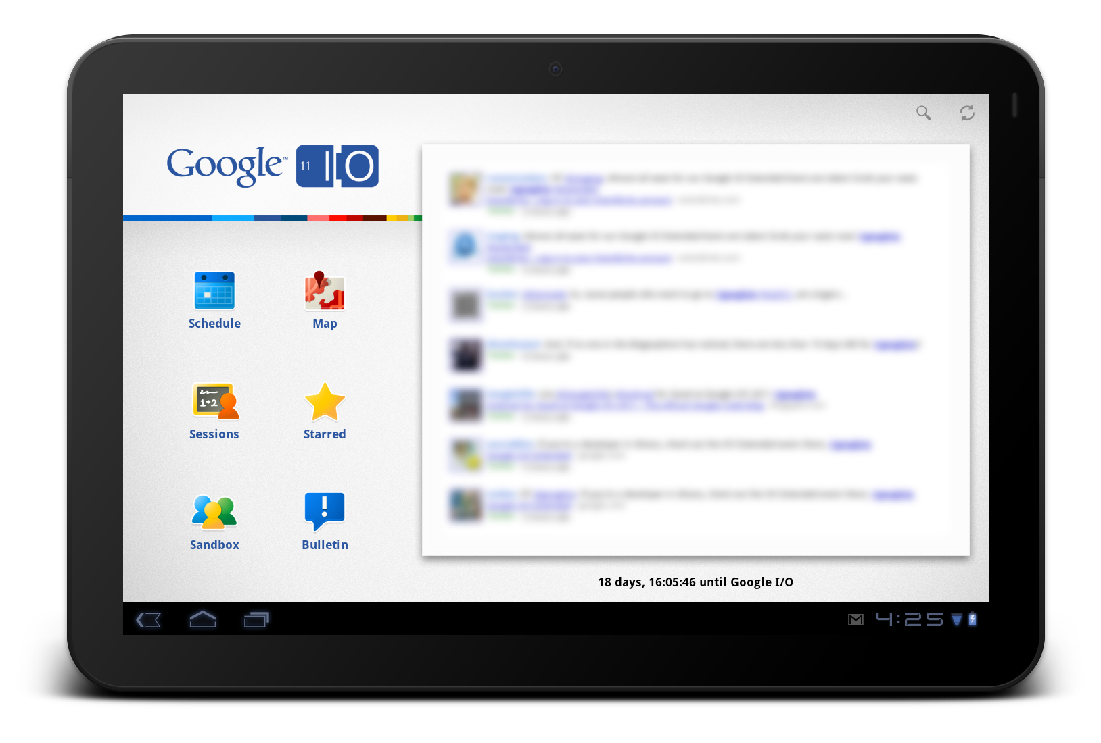

Slide 47
Demos
“Pencil” (Firefox add-on)
Android stencils at http://j.mp/androiduiutils
Fireworks-generated interactive PDF
Eclipse Android Layout Editor

Slide 48
Exercise: Begin sketching!

